Slide 1
Applying for the 2027 Mandela Washington Fellowship

Slide 2
Fellowship at a Glance
Exchange program of the Young African Leaders Initiative (YALI)
Funded by the U.S. Government
Up to 550 Fellows in summer 2027
Six-week institutes at a U.S. college or university
Nearly 7,800 Fellowship alumni since 2014
No fee to apply or participate
Notes:
Presenter
The Mandela Washington Fellowship is the exchange program of the Young African Leaders Initiative. Since 2014, the Fellowship has brought nearly 7,800 young African leaders to the United States for academic coursework, professional site visits, and structured networking.
In summer 2027, the Fellowship will bring up to 550 young leaders to the United States for a comprehensive, executive-style program to build their skills.
Fellows also develop professional connections with Americans and join a network of Fellowship alumni across Sub-Saharan Africa.
There is no fee to apply for or participate in the Mandela Washington Fellowship.

Slide 3

The Fellowship Experience
Six-week institutes at a U.S. college or university
Academic coursework
Operating in American Markets curriculum
Professional site visits and networking
Cultural exchange activities and field experience
Notes:
Presenter:
Fellows will be placed in groups of approximately 25 at institutions across the United States.
Institute faculty and local experts will deliver interactive and practical academic content. The institute model connects academic sessions with the Operating in American Markets curriculum, professional site visits, facilitated networking, cultural exchange activities, and a Field Experience.
Field Experience: A track-specific, off-campus learning experience that connects Fellows with American professionals, organizations, and industries through immersive activities designed to build practical knowledge and professional networks.
Each institute will offer a different combination of sessions and activities based on its track, location, and local expertise.
The institutes are intensive, and Fellows are expected to participate fully in all required programming

Slide 4
Leadership Institute Tracks
Business and Trade | Emerging Technologies | Governance and Security
Business operations, investment, and trade Supply chains and commercial partnerships | AI, biotechnology, robotics, and computing Technology applications across key sectors | Strong institutions and the rule of law Cybersecurity, policymaking, and conflict resolution
Notes:
Presenter:
The 2027 Fellowship features three institute tracks: Business and Trade, Emerging Technologies, and Governance and Security.
Business and Trade
The Business and Trade track is intended for professionals and officials working in business, trade, economic development, or other commercial and market-driven sectors. The track will examine U.S. business operations, investment, trade, and supply chains, including applications related to critical minerals, public-private partnerships, and technology and artificial intelligence in business. Fellows will also engage with U.S. business leaders and entrepreneurs.
Emerging Technologies
The Emerging Technologies track is intended for professionals working in areas such as information technology, artificial intelligence, data science, engineering, agricultural technology, biotechnology, or robotics. The track will explore U.S. leadership in advanced technologies and their applications in sectors such as public health, mining, agriculture, education, and cybersecurity. Fellows will also connect with American technology experts and innovators.
Governance and Security
The Governance and Security track is intended for government officials, civil servants, legal professionals, policymakers, and leaders working in governance, the rule of law, community safety, conflict prevention, cybersecurity, crisis management, or civil society. The track will examine U.S. systems that support safety, strong institutions, and the rule of law, with applications in policymaking, border management, conflict resolution, and health security. Fellows will also engage with policymakers and legal experts.
Candidate strengths may span multiple tracks. Applicants will rank their preferences, and placement will be based on their individual strengths and the needs of the Fellowship cohort.
All three tracks will share a common curriculum focused on strengthening commercial partnerships with the United States. Fellows should not anticipate identifying funding or investment opportunities during the Fellowship

Slide 5
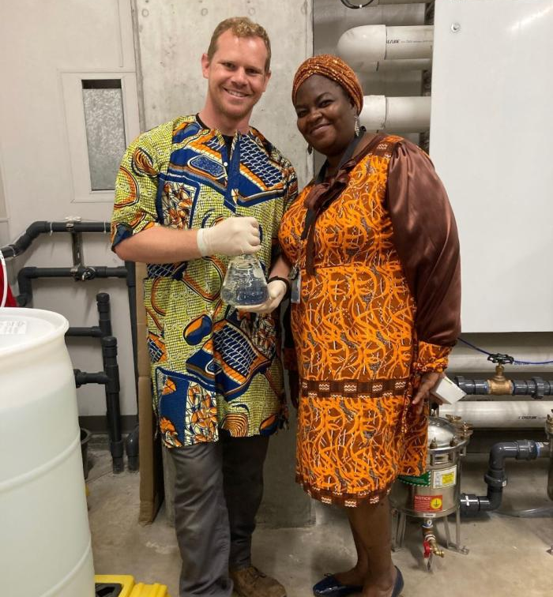
Additional Opportunities
Professional Development Experience
Approximately 50 Fellows may participate in an optional four-week placement with a U.S. organization following the institutes.
Alumni Opportunities
After the Fellowship, alumni can access professional development, networking, and collaboration opportunities, including Reciprocal Exchanges with U.S. professionals.
Notes:
Presenter:
Applicants may apply for the optional Professional Development Experience, or PDE. Applying for the PDE does not affect an applicant’s selection for the Fellowship.
Immediately following the institutes, approximately 50 Fellows will participate in a four-week placement with a U.S. organization. PDE Fellows will contribute their skills while gaining practical experience with U.S. professionals.
After completing the Fellowship, alumni can continue building their skills and professional connections through ongoing professional development, networking, and collaboration opportunities.
Through Reciprocal Exchanges, eligible U.S. professionals may collaborate with Fellowship alumni on projects in Sub-Saharan Africa that build on connections developed through the Fellowship.
Additional information about these opportunities is available on the Fellowship website.

Slide 6
Fellowship Provisions and Expectations
The Fellowship Covers
J-1 Visa support
Required International and domestic travel
Housing and meals
Limited accident and sickness coverage
Program costs
Fellows Should Plan For
An intensive six-week commitment
Personal expenses and uncovered medical costs
Returning home after the program, per J-1 visa requirements
Notes:
Presenter guidance: Presenters who are not U.S. Government personnel should not advise applicants on their individual visa eligibility. Applicants with questions about whether they are eligible to receive a J-1 visa should contact their local U.S. embassy or consulate.​
​
Presenter note for alumni: Before conducting recruitment outreach, alumni should contact the Public Affairs Section at their local U.S. embassy or consulate to confirm any country-specific considerations, including whether the embassy is actively recruiting for the 2027 Fellowship. Embassy staff can provide the most current guidance on recruitment priorities and approved outreach activities.​
Presenter:
There is no fee to apply for the Mandela Washington Fellowship. If selected, the Fellowship will cover program costs, including J-1 visa support, required international and domestic travel, housing and meals, and a limited accident and sickness benefit plan.
The Fellowship does not supplement Fellows’ salaries or cover personal expenses at home. Fellows are also responsible for medical expenses that are not covered by the limited benefit plan and baggage fees beyond the amount provided by the Fellowship.
The Fellowship is an intensive program. Fellows must be prepared to focus their full attention on required activities throughout the six-week Institute.
All Fellows participate on J-1 visas and must follow the applicable visa requirements, including returning home after the program.
Applicants should review the full provisions and expectations on the Fellowship website before applying.

Slide 7
Who Should Apply?
Applicants Must
Be citizens and residents of an eligible Sub-Saharan African country
Be ages 25 to 35, with exceptional applicants ages 21 to 24 considered
Be proficient in English
Be eligible for a J-1 visa
Meet all additional eligibility requirements listed online
Applicants with disabilities are encouraged to apply. Reasonable accommodation will be provided for Fellows with disabilities.
Notes:
​
Presenter:​
​
The Mandela Washington Fellowship is open to young African leaders who meet all technical eligibility requirements.​
​
Applicants must be citizens and residents of an eligible Sub-Saharan African country. Applicants generally must be between the ages of 25 and 35 when they submit the application, although exceptional applicants ages 21 to 24 may be considered.​
​
Applicants must also be proficient in English, be eligible to receive a J-1 visa, and meet the additional eligibility requirements listed on the Fellowship website.​
​
Applicants with disabilities are encouraged to apply. Reasonable accommodation will be provided for Fellows with disabilities. More information for applicants with disabilities is available on the Fellowship website.​

Slide 8
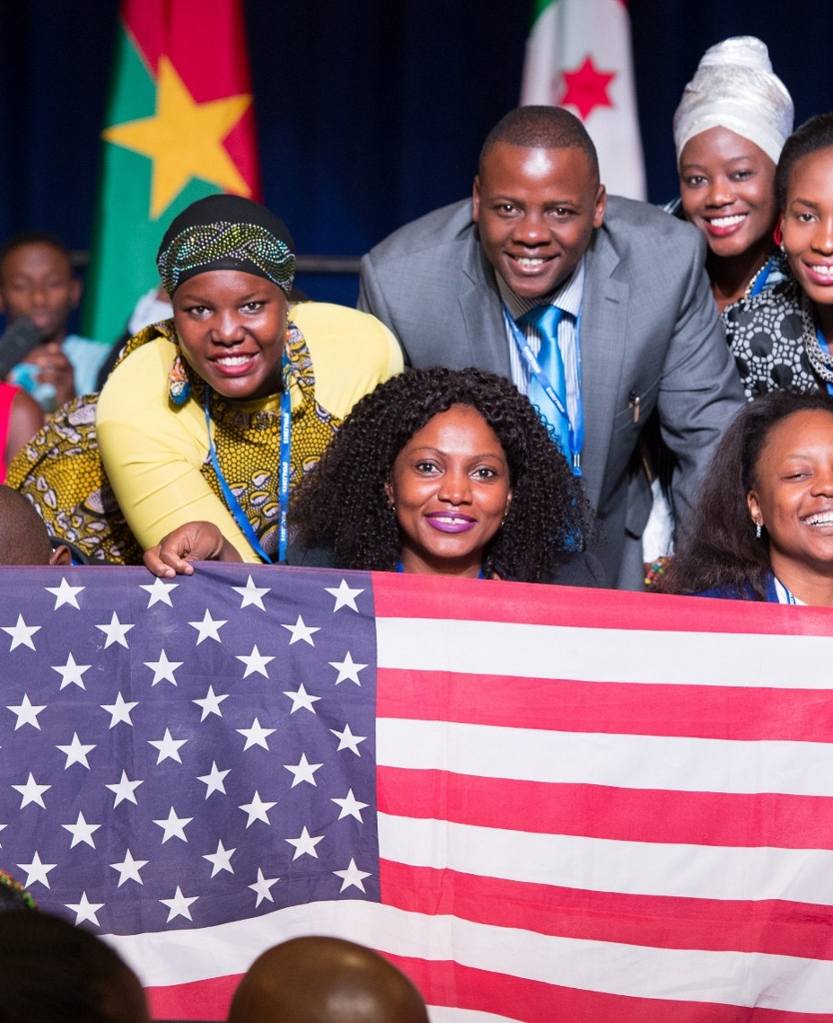
Strong Applicants Demonstrate
Accomplishment in business, trade, emerging technologies, governance, or security
Interest in building lasting relationships with U.S. organizations and businesses
Ability to collaborate, communicate, and adapt in different environments
Commitment to return to Sub-Saharan Africa and serve their communities
Notes:
Presenter:
The selection process is a merit-based open competition. Meeting the technical eligibility requirements does not guarantee selection.
Strong applicants demonstrate accomplishment in business, trade, emerging technologies, governance, or security. Their experience should align clearly with one of these sectors.
Competitive applicants are interested in building lasting relationships with U.S. organizations and businesses. They should also be able to collaborate, communicate, and adapt in different environments.
Applicants should demonstrate a commitment to return to Sub-Saharan Africa after the Fellowship and apply what they have learned in service to their communities.

Slide 9
How to Apply
Apply online at mwfellows.info/apply
Review the instructions and eligibility requirements
Allow enough time to complete the application
Use specific examples from your experience
Submit original responses in your own words
Notes:
Presenter:
The Fellowship application is completed online. Applicants should begin by reviewing the instructions and confirming that they meet all eligibility requirements.
Allow enough time to complete the application carefully. Applicants can save their progress and return to the application before submitting it.
Use specific examples from your professional and community experience to demonstrate how you meet the selection criteria. Clearly explain your impact, goals, and connection to your preferred track.
All application responses must reflect the applicant’s own experience, words, and ideas. Plagiarism is strictly prohibited and may result in disqualification.
Review the application carefully before submitting it. Applicants will not be able to make changes after final submission.

Slide 10
Application Timeline
Application Timeline
Application opens: September 22
Application closes: October 13
Semifinalist interviews: November 2026 to January 2027
Applicants notified: February 2027
Fellowship begins: Summer 2027
Local Embassy Contact
Name
Email
Phone
Notes:
Presenter:
The application opens on September 22 and closes on October 13.
After the application deadline, eligible applications will be reviewed. Semifinalists will be interviewed by the U.S. embassy or consulate in their country.
Applicants will be notified of their status in March 2027. Selected Finalists will then complete visa processing and attend required pre-departure activities before the Fellowship begins in summer 2027.
Applicants should visit the Fellowship website for the complete application instructions, eligibility requirements, application tips, and current timeline.
For questions about the recruitment and selection process, applicants may also contact the local U.S. embassy representative listed on this slide.
Posts: Please insert your local contact information before presenting.

Slide 11
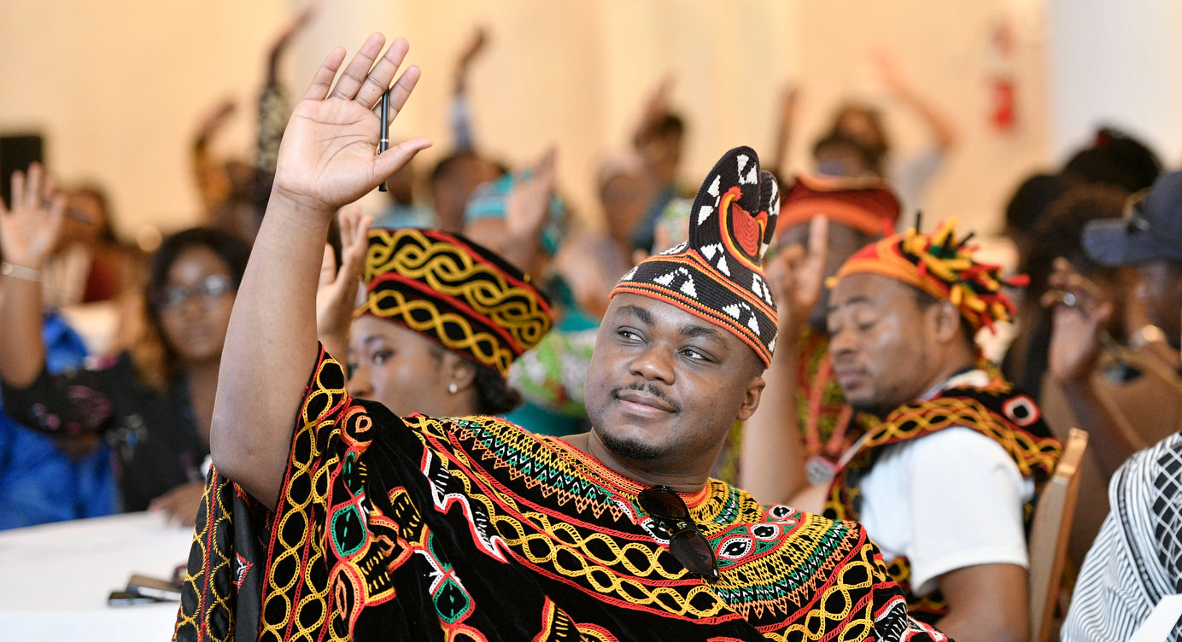
Questions?
Learn more about the Fellowship and application at mwfellows.info/apply
Notes:
Presenter:
Thank you for your interest in the 2027 Mandela Washington Fellowship. We welcome your questions.
For complete application information and the most current guidance, please visit the Fellowship website.

